Slide 1
Data Modeling: Data Modeling Using the Entity-Relationship Model
Vijay Dialani
Boise State University
Special Thanks to Pearson’s Publishing for use of their instructional material

Slide 2
References
For self study, please refer to:
Chapter 1, 2 and 3 from 5th Edition
Chapter 1, 2 and 7 from 6th Edition

Slide 3
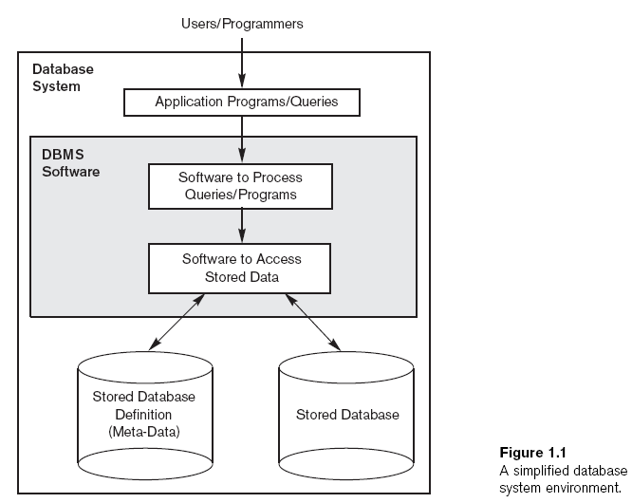
Revision: What is a Database?
Database
Collection of related data
Known facts that can be recorded and that have implicit meaning
Miniworld or universe of discourse (UoD)
Represents some aspect of the real world
Logically coherent collection of data with inherent meaning
Built for a specific purpose

Slide 4
Revision: How is data organized?
Data is represented as entities and their related attributes.
Attributes have a logical meaning and an associated data type
Attribute’s data type determines operations permitted on an attribute
Related entities form a mini world or universe of discourse

Slide 5
Revision: Single Database Multiple User Views
A database may provide multiple different views to end users.
For example, student database can be used for Student and Financial Reports
Also, an inventory database can be used to manage purchases and sales orders
Multiple Users use the same underlying Conceptual Schema
The physical storage of the data may be different than conceptual schema

Slide 6
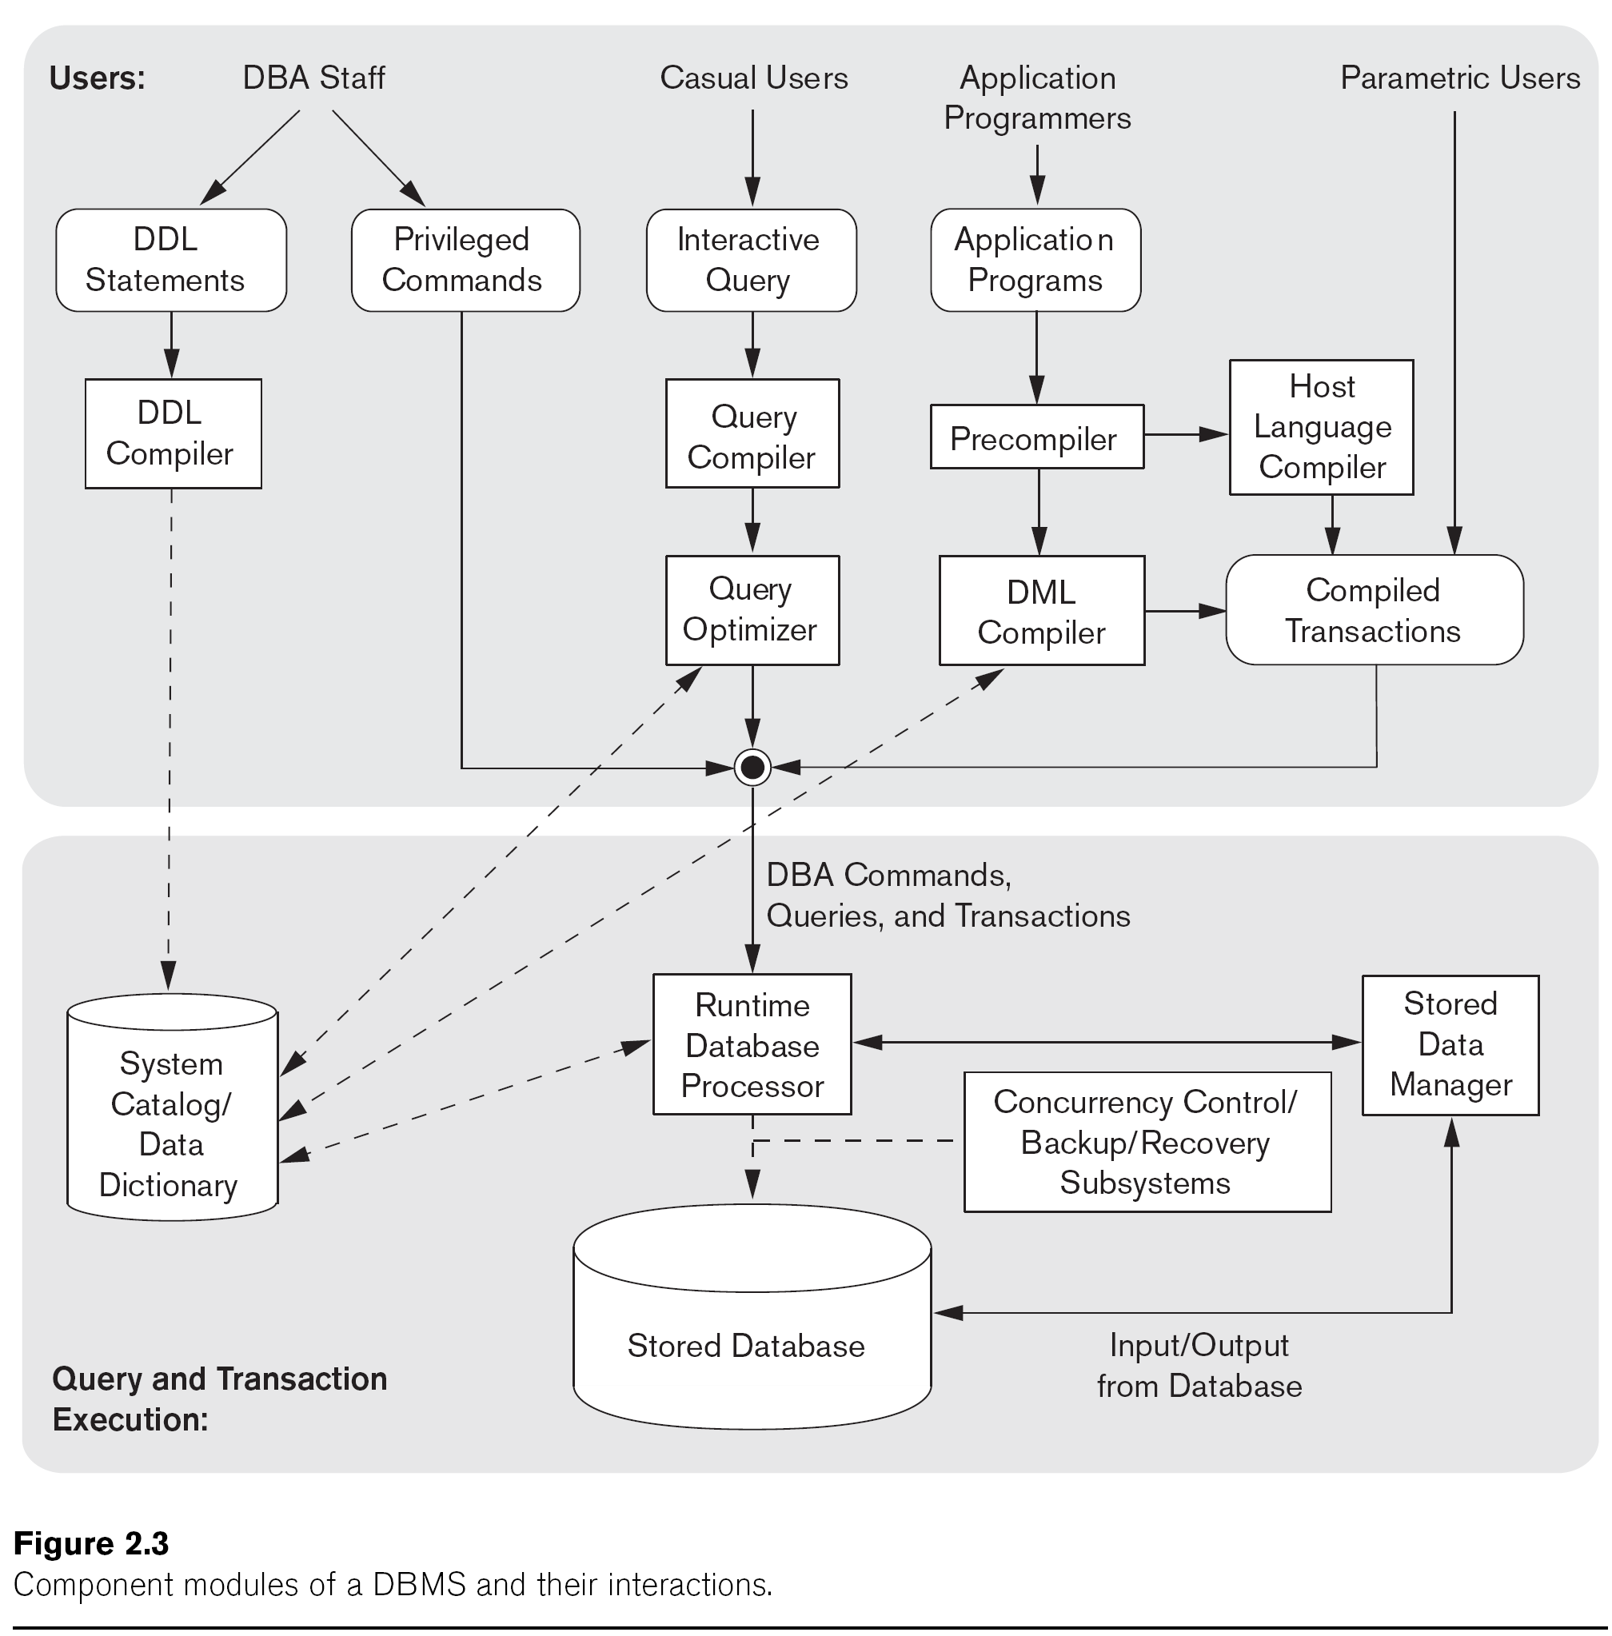
Types of Database Users
Types of Database Users
DBA Staff
Casual Users
Application Programmers
Parametric Users

Slide 7
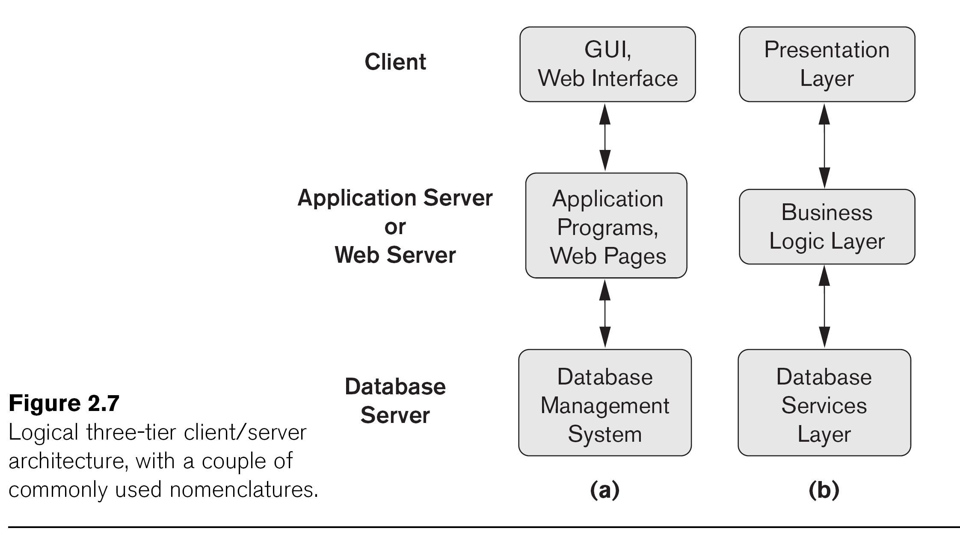
Why are Databases also known as Backend Systems?
Most applications are built on top of database systems
Many applications may end up using the same database instance

Slide 8
Phases in Database Design

Slide 9
Why have a Data Model?
A Data Model simplifies:
Requirements collection and analysis
Database designers interview prospective database users to understand and document data requirements
Result: data requirements
Functional requirements of the application
Design of Conceptual schema
Conceptual design
Description of data requirements
Includes detailed descriptions of the entity types, relationships, and constraints
Transformed from high-level data model into implementation data model

Slide 10
An example database?
COMPANY
Employees, departments, and projects
Company is organized into departments
Department controls a number of projects
Employee: store each employee’s name, Social Security number, address, salary, sex (gender), and birth date
Keep track of the dependents of each employee

Slide 11
Entity Relationship model
ER model describes data as:
Entities
Keys
Relationships
Attributes

Slide 12
Entities in an ER model
Two Example Entities:
Employee
Company

Slide 13
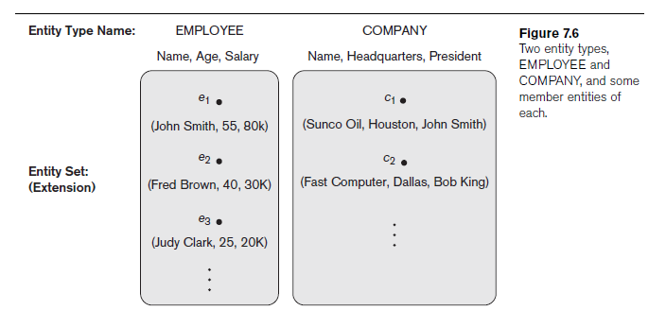
Entity Type
Entity type
Collection (or set) of entities that have the same attributes

Slide 14
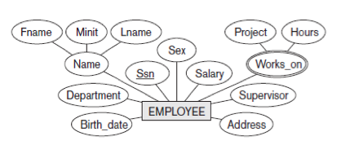
Key in an ER model
Key or uniqueness constraint
Attributes whose values are distinct for each individual entity in entity set
Key attribute
Uniqueness property must hold for every entity set of the entity type

Slide 15
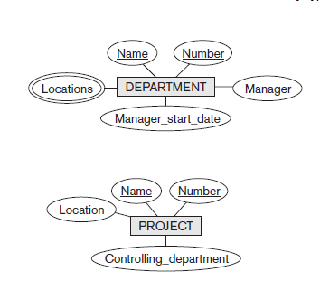
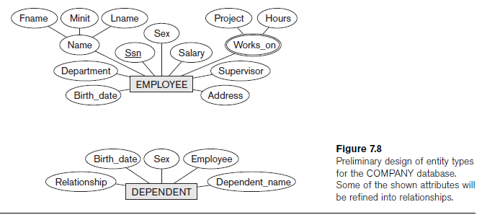
Company Database: Entity and Attribute Types
Attributes
Particular properties that describe entity
Types of attributes:
Composite versus simple (atomic) attributes (e.g Name)
Single-valued versus multivalued attributes (e.g. Works On)
Stored versus derived attributes (e.g. Number of Employees)
NULL values (Supervisor for CEO)
Complex attributes

Slide 16
Examples of Attribute Types

Slide 17
Relation Types – Simple Relation

Slide 18
Relation Types – Ternary Relation

Slide 19
Relation Types – Recursive Relation

Slide 20
Relation Types – 1:1 Cardinality

Slide 21
Relation Types – M:N Cardinality Relation

Slide 22
Symbols Revisited

Slide 23
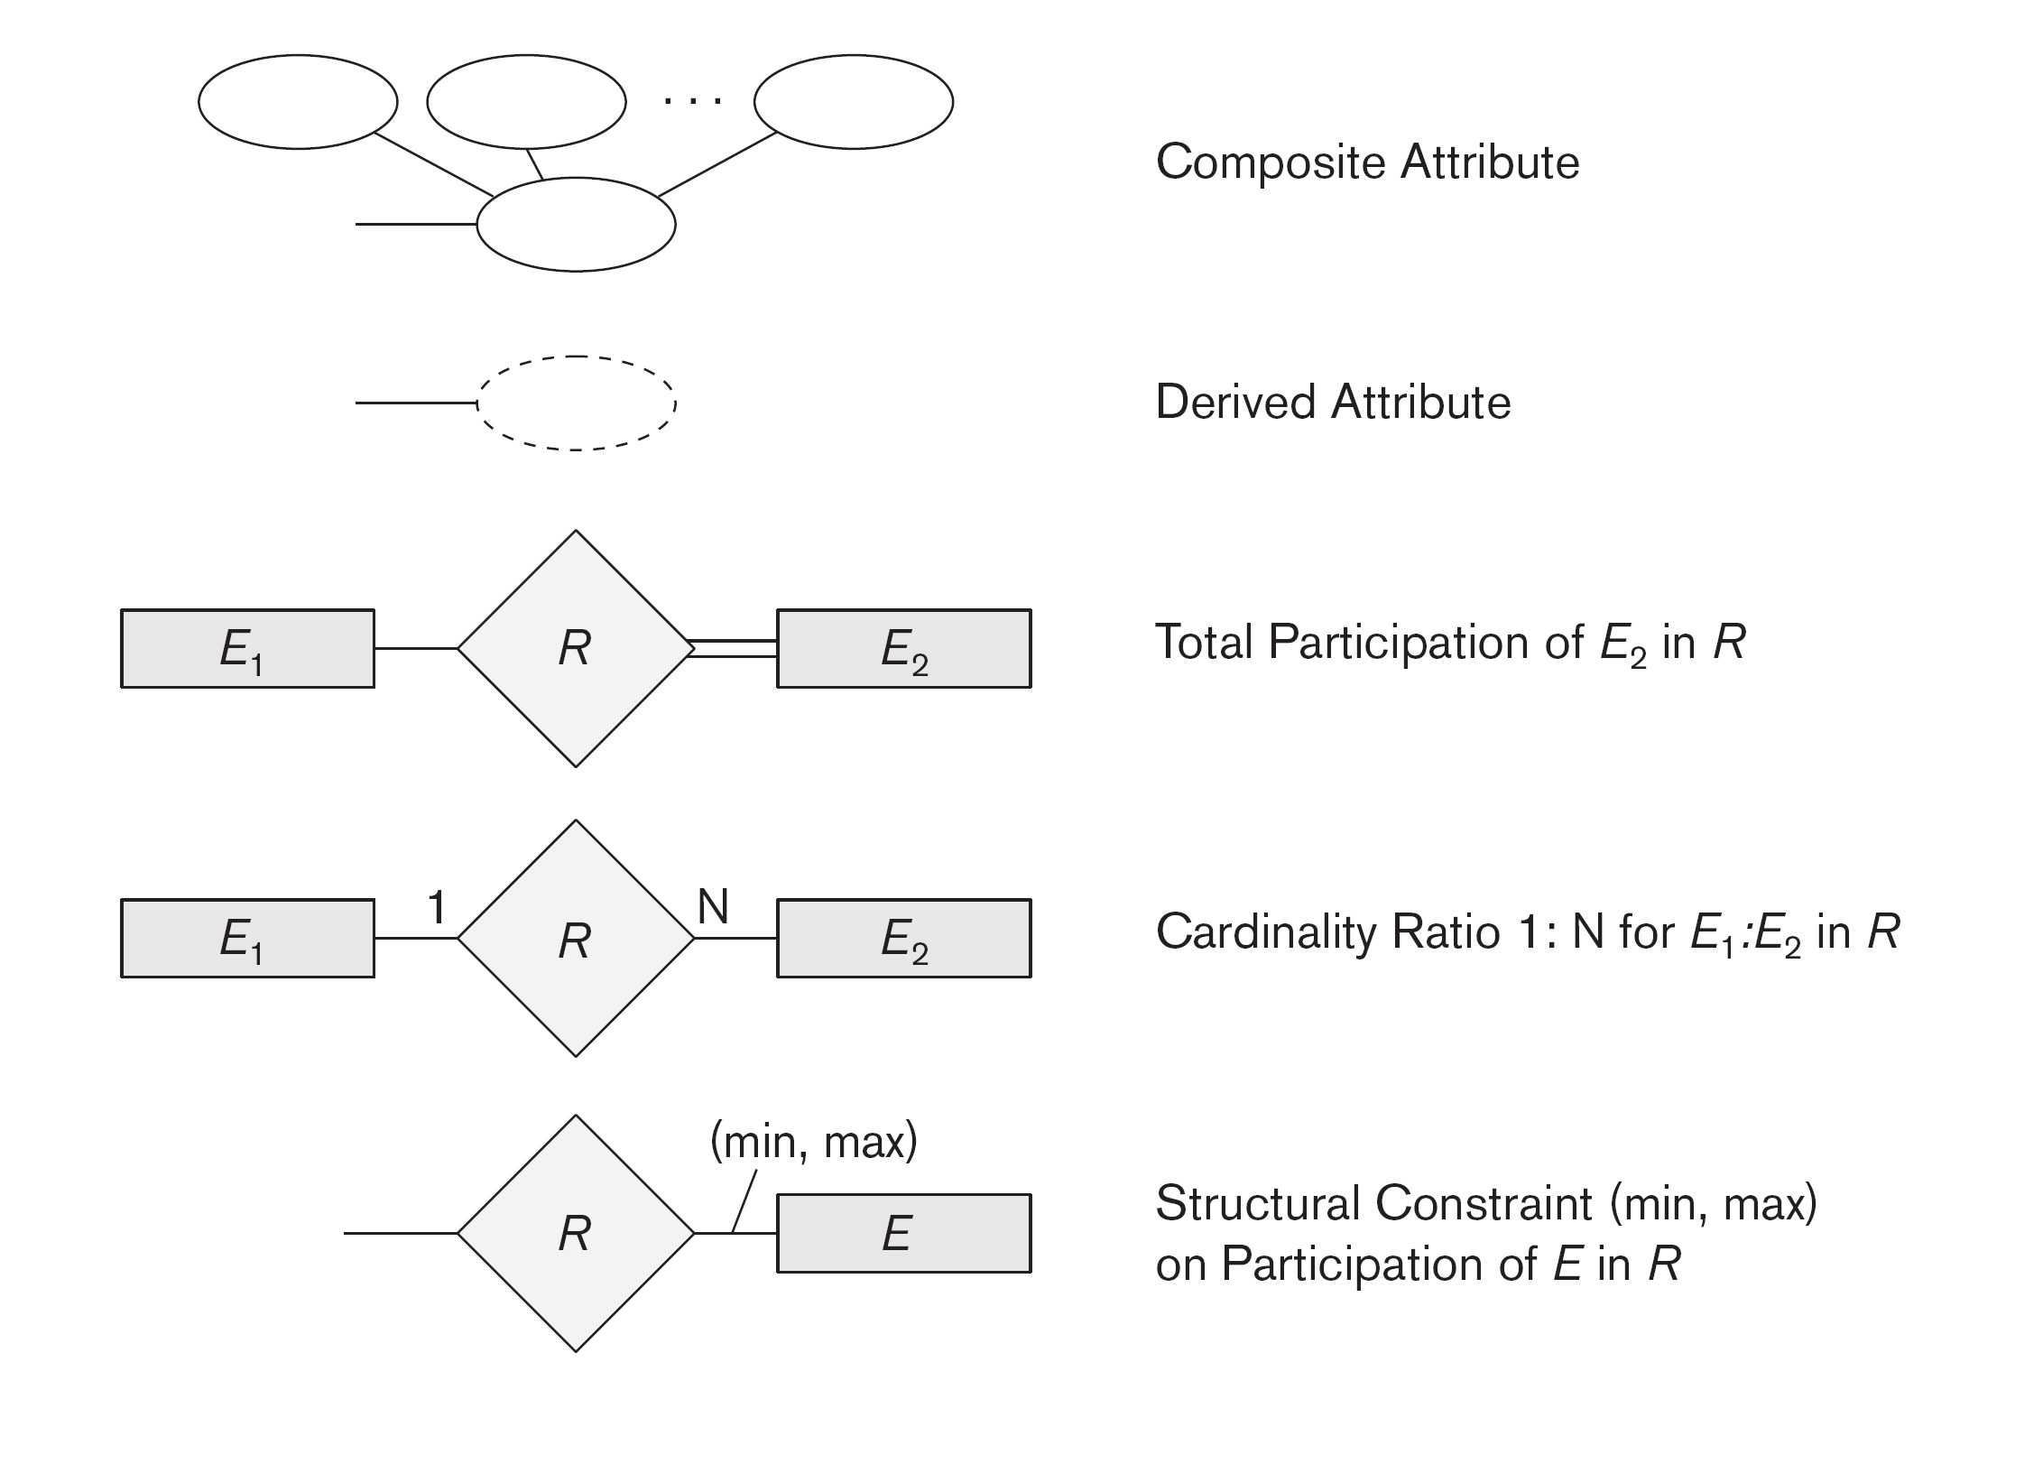
Symbols Revisited

Slide 24
Company Data Model

Slide 25
Company Data Model in UML (Unified Modeling Language)

Slide 26
Bank Data Model

Slide 27
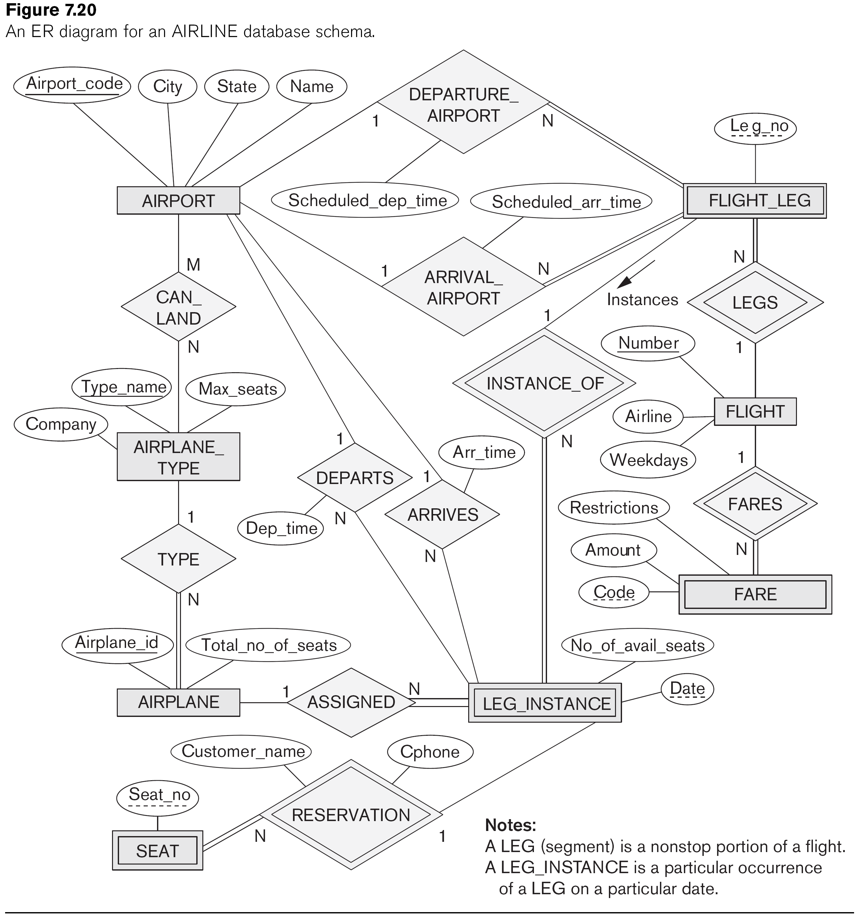
Airlines Data Model

Slide 28
Summary
Basic ER model concepts of entities and their attributes
Different types of attributes
Structural constraints on relationships
ER diagrams represent E-R schemas
UML class diagrams relate to ER modeling concepts

